Slide 1

COGNITIVE AI-BASED MULTI-DOCUMENT TEXT SUMMARIZATION WITH VISUAL INSIGHT EXTRACTION USING LIGHTWEIGHT NLP TECHNIQUES
Submitted by
K.Vinay Kumar
22HP1A4262
Under the Guidance of
Dr.K.Sivaramakrishna
(Associate Professor)
Institution
Department of Computer Science and Engineering (AI & ML)
Andhra Loyola Institute of Engineering and Technology
Vijayawada, Andhra Pradesh, India
Conference:
Journal of Computer and Electrical Sciences (JCES)
Volume-1 Issue-3, March 2026

Slide 2
ABSTRACT
Text summarization plays a crucial role in Natural Language Processing (NLP) for extracting meaningful information from large volumes of data. This project presents a Cognitive AI-Based Multi-Document Text Summarization System that generates accurate and concise summaries from multiple input formats such as PDF documents, images, and raw text.
The system utilizes PDF parsing and Optical Character Recognition (OCR) techniques to extract textual content from both digital and scanned documents. The extracted data is processed through text preprocessing techniques, including noise removal and normalization, to improve data quality.
A frequency-based extractive summarization approach is applied to generate both page-wise summaries and a final comprehensive summary, ensuring important information is retained while reducing redundancy. In addition to text summarization, the system incorporates visual content analysis to detect figures and tables and generate meaningful insights from them. The implementation is carried out using JavaScript, PDF.js, and Tesseract.js within a web-based interface.
Experimental results demonstrate that the system effectively handles multi-format documents, produces accurate summaries, and enhances document understanding through integrated visual insights.

Slide 3
AIM OF THE PROJECT
The main aim of this project is to develop a Cognitive AI-Based Multi-Document Text Summarization System that can efficiently process and summarize large volumes of data from multiple input formats.
The project focuses on:
To design a system that supports multi-format inputs such as PDF documents, images, and raw text
To extract textual content using PDF parsing and Optical Character Recognition (OCR) techniques
To implement text preprocessing methods for cleaning and improving data quality
To generate accurate and concise summaries using a frequency-based extractive approach
To provide both page-wise summaries and a final comprehensive summary
To incorporate visual content analysis for detecting figures and tables and generating meaningful insights
To develop a user-friendly web interface for easy interaction and result visualization
To enhance overall document understanding and usability

Slide 4
LITERATURE SURVEY
Existing System (Based on Research Paper)
Recent research focuses on AI-based visual summarization systems that convert large data into graphical representations such as infographics
The system supports multi-language input and translation using advanced models like GPT, Gemini, and LLaMA. It generates visual summaries using icons, templates, and structured layouts
Uses pre-trained language models for text summarization and keyword extraction
Improves user understanding through visual representation instead of plain text
However, the system has limitations:
Focuses mainly on visual infographic generation rather than detailed text summarization
Requires high computational resources and complex models. Does not effectively support PDF and image-based document processing (OCR)
Limited ability to provide structured summaries like page-wise and final summaries
Proposed System (Our Work)
Introduces a Cognitive AI-Based Text Summarization System with visual insight extraction
Supports multi-format inputs: PDF, images, and text .Uses PDF.js and OCR techniques for accurate text extraction. Applies frequency-based summarization for efficient and interpretable results
Generates: Page-wise summaries & Final comprehensive summary
Provides structured output (Overview, Methodology, Results, Conclusion)
Designed as a lightweight and user-friendly web application

Slide 5
PROBLEM STATEMENT
In the current digital era, large volumes of textual data such as research papers, reports, and documents are generated continuously, making it difficult to extract meaningful information efficiently.
Existing systems face several limitations:
Manual reading of documents is time-consuming and inefficient
Traditional summarization methods fail to capture important and relevant information effectively
Most systems support only single-format input and cannot handle PDFs and images together
Lack of integration of OCR techniques for extracting text from scanned documents
Existing approaches do not provide structured summaries (page-wise and final summaries)
Limited capability to analyze visual elements such as figures and tables
Advanced AI-based systems require high computational resources and are complex to implement
Therefore, there is a need for a system that can efficiently process multi-format documents, generate accurate summaries, and provide visual insights to enhance document understanding.

Slide 6
SYSTEM REQUIREMENTS
Hardware Requirements
Processor: Intel i3 or above
RAM: 4 GB or above (8 GB recommended)
Storage: Minimum 500 MB free space
System Type: 64-bit system
Internet: Required for loading libraries and execution
Software Requirements
Operating System: Windows / Linux / macOS
Programming Language: JavaScript
Technologies Used: HTML, CSS, JavaScript
Libraries & Tools:
PDF.js (for PDF text extraction)
Tesseract.js (for OCR – image to text)
Development Tools: VS Code / Web Browser
Framework: Web-based Application
Functional requirements define what the AI Cognitive Summarizer does, while non-functional requirements define how efficiently, securely, and reliably it performs those tasks.

Slide 7
FEASIBILITY STUDY & APPLICATIONS
Feasibility Study
1. Technical Feasibility
Uses lightweight technologies like JavaScript, PDF.js, and Tesseract.js
No need for heavy GPU or complex deep learning models
Easy to implement as a web-based application
2. Economic Feasibility
Uses open-source tools and libraries
Low development and maintenance cost
No expensive infrastructure required
3. Operational Feasibility
Simple and user-friendly interface
Requires minimal technical knowledge to use
Suitable for students, researchers, and professionals
Applications
Research Paper Summarization
Report and Document Analysis
Educational Content Summarization
Business Document Processing
News and Article Summarization
Image-based Text Extraction and Analysis
Automated Document Understanding Systems

Slide 8
SDLC – REQUIREMENT ANALYSIS
Functional Requirements
The system should allow users to upload documents (PDF and images)
The system should identify input type (PDF or image)
The system should extract text using:
PDF.js for PDF files
OCR (Tesseract.js) for images
The system should perform text preprocessing (cleaning, normalization)
The system should generate:
Page-wise summaries
Final comprehensive summary
The system should detect figures and tables
The system should provide visual insights and explanations
The system should display results through a web interface
Non-Functional Requirements
The system should be fast and efficient
The system should be lightweight and low-resource consuming
The system should provide accurate and reliable summaries
The system should have a user-friendly interface
The system should be scalable and easy to maintain
The system should ensure proper handling of different document formats

Slide 9
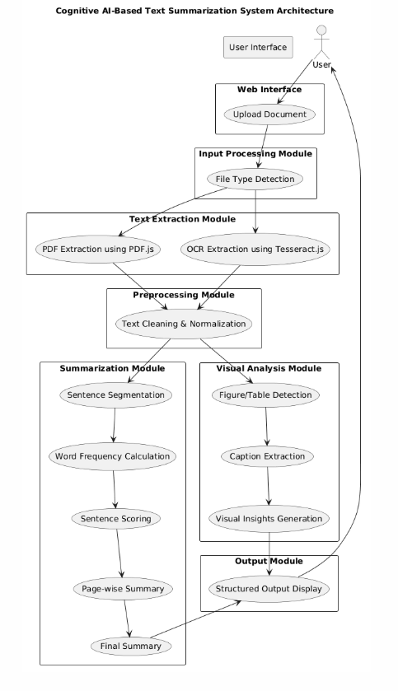
SDLC – DESIGN
The proposed system follows a modular architecture that processes documents through multiple stages to generate meaningful summaries and visual insights.
Initially, the user uploads a document (PDF or image) through the web interface. The system then performs file type detection to determine the appropriate processing method.
In the text extraction module, PDF files are processed using PDF.js, while image-based documents are processed using OCR (Tesseract.js) to extract textual content.
The extracted text is passed to the preprocessing module, where unwanted data such as noise, repeated headers, and irrelevant content are removed, and the text is normalized.
Next, the summarization module applies a frequency-based approach involving sentence segmentation, word frequency calculation, and sentence scoring to generate page-wise summaries and a final summary.
Simultaneously, the visual analysis module detects figures and tables, extracts captions, and generates meaningful insights to enhance document understanding.
Finally, the output module combines summaries and visual insights and presents them in a structured format through the user interface.

Slide 10
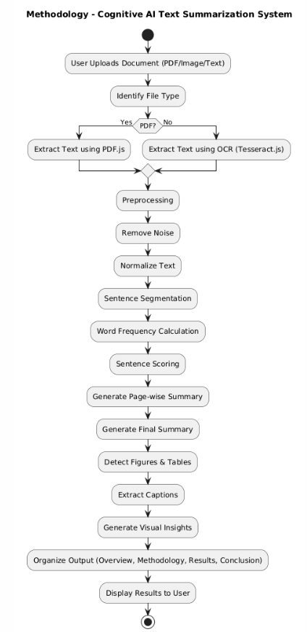
SDLC – IMPLEMENTATION
The implementation of the system follows a step-by-step methodology to process documents and generate accurate summaries along with visual insights.
Initially, the user uploads a document in the form of a PDF, image, or text. The system identifies the file type and applies the appropriate text extraction technique, using PDF.js for PDF files and OCR (Tesseract.js) for images.
The extracted text undergoes preprocessing, where noise such as repeated headers and irrelevant content is removed, and the text is normalized.
Next, the system performs sentence segmentation, calculates word frequency, and assigns scores to sentences based on importance. Using this, it generates page-wise summaries and a final comprehensive summary.
In parallel, the system performs visual content analysis by detecting figures and tables, extracting captions, and generating meaningful insights.
Finally, the system organizes the output into structured sections and displays the summaries and visual insights through the user interface.

Slide 11
SDLC – TESTING & RESULTS
Testing Approach
The system was tested using multiple types of documents to evaluate its performance under different scenarios:
Text-rich documents (research papers, reports)
Moderate content documents
Image-based documents (scanned files using OCR)
Visual-dominant pages (figures, tables, diagrams)
Noisy data (repeated headers, irrelevant content)
Test Scenarios & Observations
Text-rich pages: Generated clear and accurate summaries with important information retained
Moderate content pages: Produced relevant summaries with slightly reduced contextual detail
Image-based input: OCR successfully extracted text and enabled summarization
Visual-dominant pages: Detected figures and tables and generated meaningful insights
Noisy content:Preprocessing effectively removed unwanted data and improved output quality
Results
Generated page-wise summaries for multi-page documents
Produced a final comprehensive summary
Successfully handled multi-format inputs (PDF + images)
Accurately extracted text using PDF.js and OCR
Detected and analyzed visual elements (figures and tables)
Displayed structured output (Overview, Methodology, Results, Conclusion)
Achieved efficient and consistent performance
System Performance
Fast processing with low computational requirements
High accuracy in identifying important sentences
Improved document understanding through visual insights
Reliable performance across different document types

Slide 12
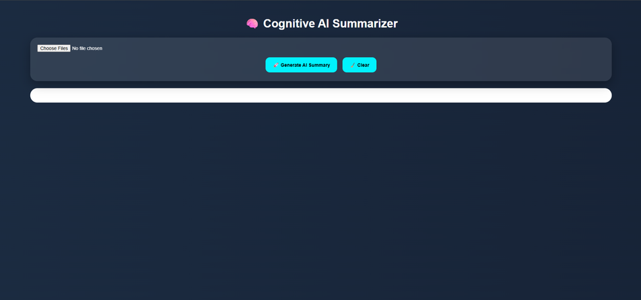
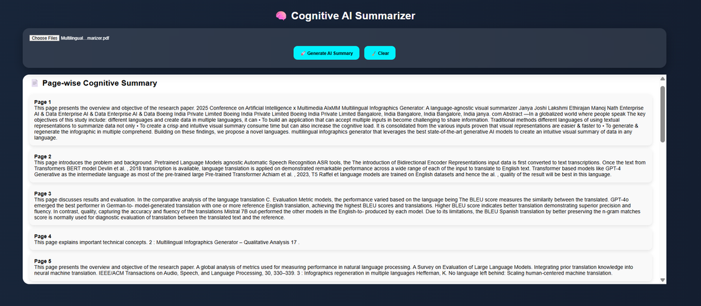
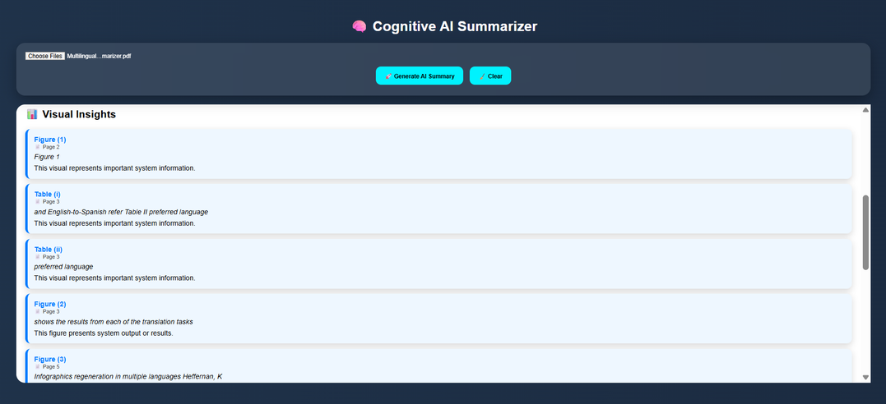
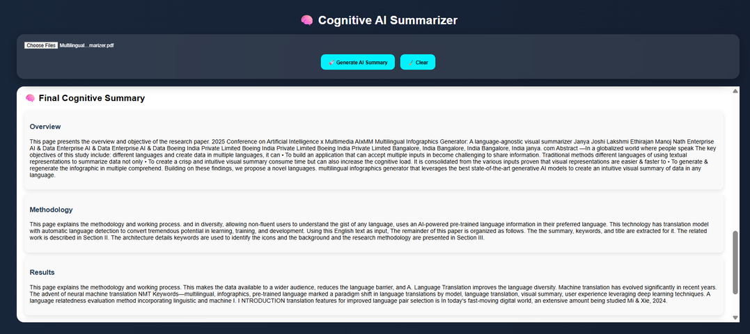
RESULTS:

Slide 13
CONCLUSION & FUTURE WORK
Conclusion
The proposed system successfully implements a Cognitive AI-Based Text Summarization approach
Effectively processes multi-format inputs such as PDFs and images
Utilizes PDF parsing and OCR techniques for accurate text extraction
Generates page-wise and final summaries with reduced redundancy
Incorporates visual content analysis to detect figures and tables
Provides structured and user-friendly output
Achieves efficient, scalable, and reliable performance
Future Work
Integration of advanced deep learning models (LSTM, Transformers) for better contextual understanding
Support for multilingual text summarization
Development of real-time document processing systems
Enhanced visual analysis for complex diagrams and charts
Deployment as a mobile or cloud-based application
Improvement in OCR accuracy for low-quality images

Slide 14
THANK YOU

